Slide 1
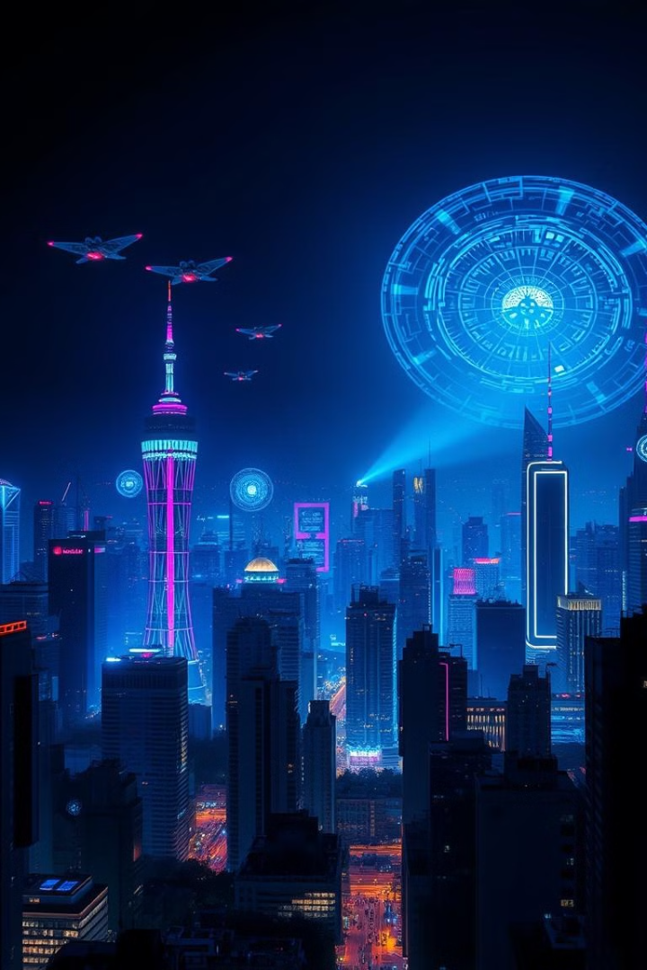
Futuristic Portfolio Showcase
Name : Atul Rathour
Roll no : 21
Branch : IT
Enrollment No : 22002170210100

Slide 2
3D Models and Cutting-Edge Design
Pushing Boundaries
Intuitive Design
Creative Vision
I strive to push the boundaries of 3D modeling, crafting visually stunning and technically advanced creations that capture the essence of the future.
My designs are not only aesthetically pleasing but also user-friendly, considering functionality and accessibility.
Every project starts with a clear vision, translated into unique and imaginative 3D models that tell a story.

Slide 3
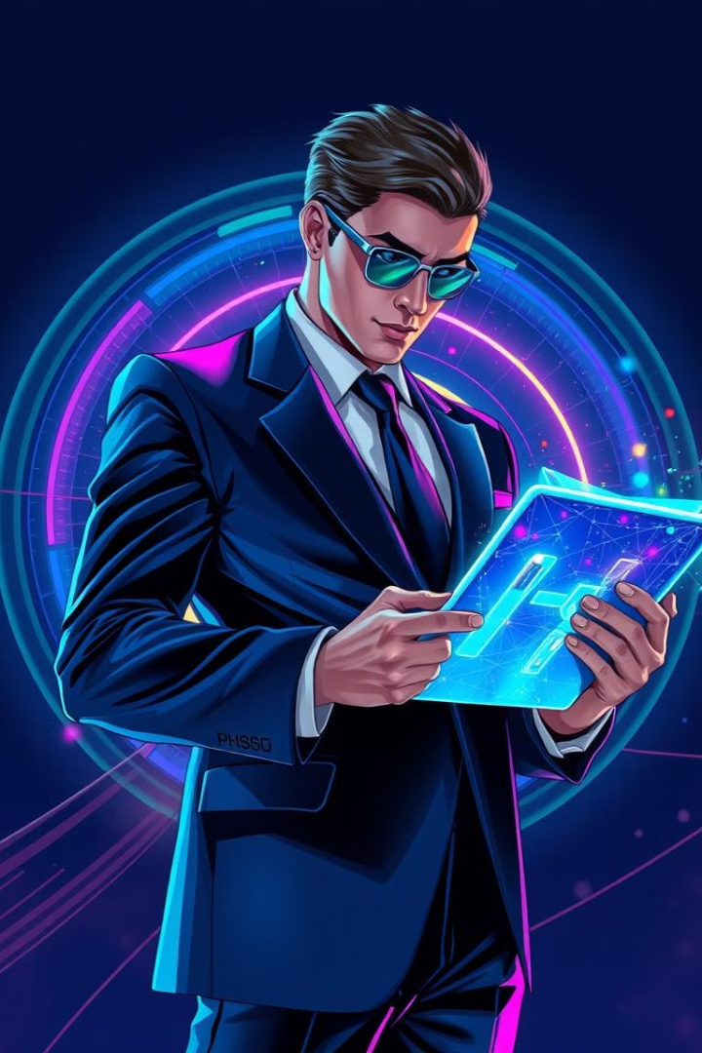
Highlighting My Skills and Expertise
1
3D Modeling
2
Concept Design
Proficient in industry-standard software, creating photorealistic models with intricate details and textures.
Developing innovative concepts that translate into engaging and visually compelling 3D models.
3
Visual Storytelling
4
Collaboration
Using 3D modeling to tell stories, create immersive experiences, and bring abstract ideas to life.
Working effectively in teams, collaborating with designers, developers, and clients to achieve shared goals.

Slide 4
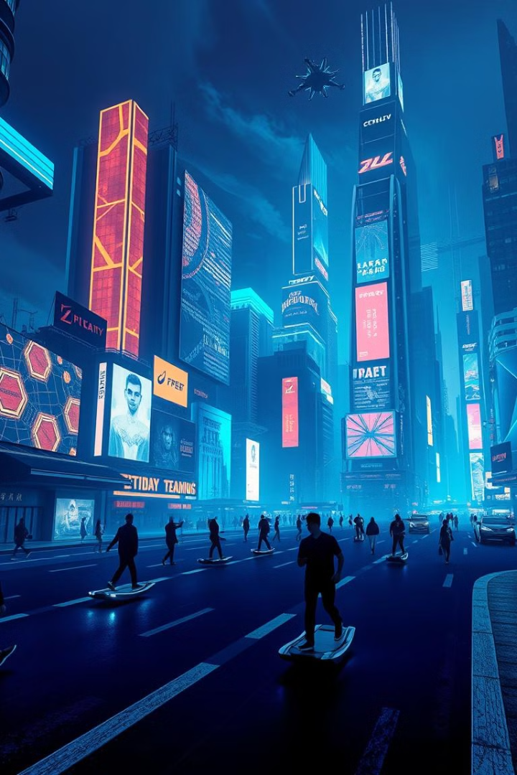


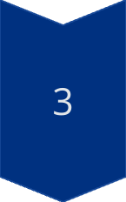
Conveying My Vision and Passion
Conceptualization
I start by understanding the project's objectives and developing a clear conceptual framework.
Design and Development
I utilize my skills in 3D modeling, animation, and visual effects to bring the concepts to life.
Final Presentation
The final product is a visually captivating and technically impressive 3D model that showcases my vision.

Slide 5
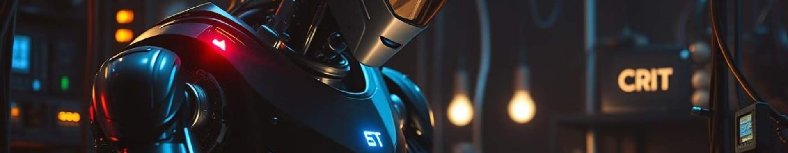
Challenges Faced
Technical Complexity
Navigating the complexities of 3D software, ensuring smooth workflow and efficient rendering.
Time Constraints
Balancing creative vision with project deadlines, optimizing time management and prioritizing tasks.
Concept Exploration
Consistently pushing boundaries to create innovative and visually compelling 3D models.

Slide 6
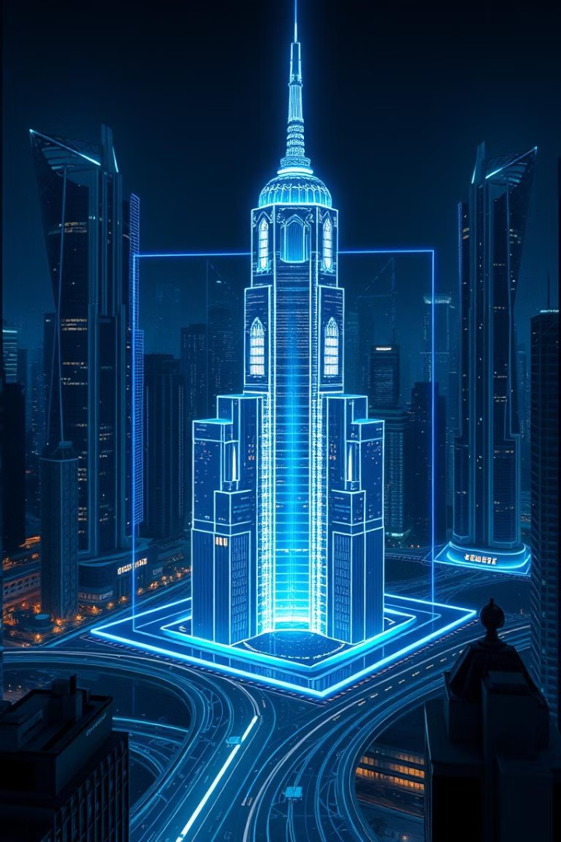
Scope
3D Product Design
Architectural Visualization
Creating detailed 3D models for product visualization and marketing purposes.
Developing immersive 3D models of buildings and structures for architectural presentations and design proposals.
Virtual Reality Experiences
Game Development
Developing 3D assets for games, including characters, environments, and objects.
Designing 3D models for VR environments, creating immersive and interactive experiences for users.

